Slide 1
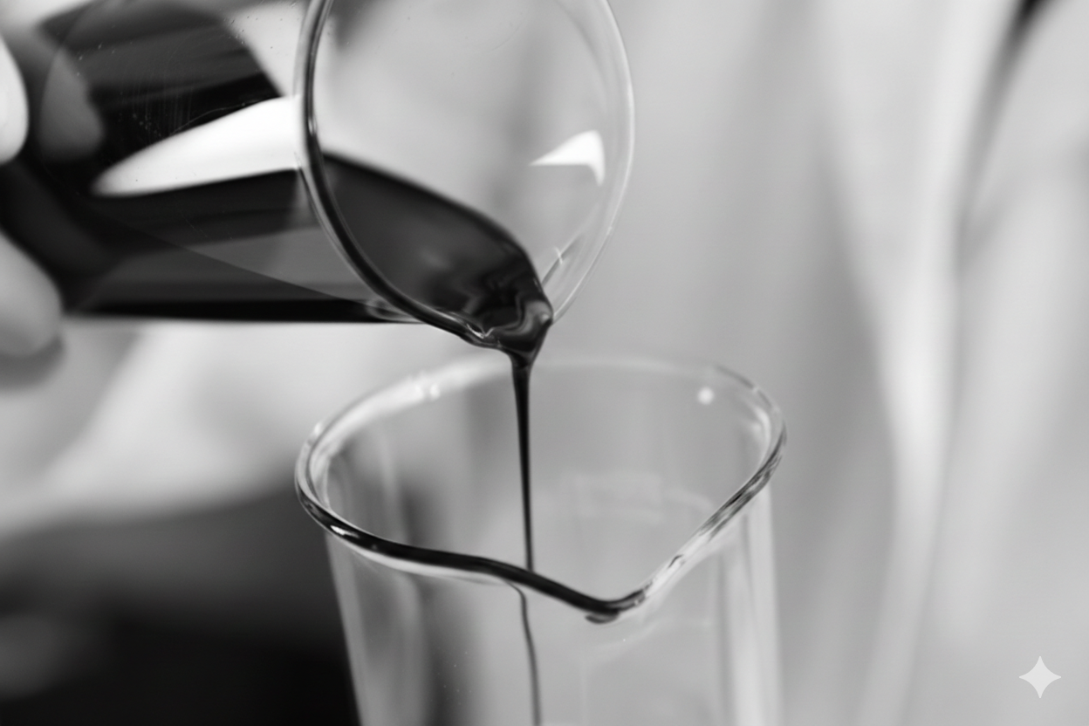
Hidden Margin in the Naphtha Stream
“Every refinery produces naphtha. Not every refinery captures its full value”
Naphtha is priced lower than finished gasoline
It lacks the required performance to be used directly as petrol
Converting it usually requires costly refinery infrastructure
The naphtha - gasoline spread represents a recurring margin opportunity.

Slide 2
Naphtha: An 8–10% Lever on the $2.6T Crude Complex V1 // Do not use
Crude Oil Market Value (USD) ~$2.6 T Volume ~5,200 Mt/y
Naphtha Market Value (USD) ~$211 Billion Volume ~500 Mt/y Growth ~ 4.4%
Petrol Market Size (USD) ~ $129.6 B Volume - 5,013.4(MMT)
The "So What?" Naphtha is ~8.12% of Global crude oil Naphtha accounts for ~10% of global oil use Petrol is ~5% of Global crude oil

Slide 3
Market Scenario & the Spread
Crude Oil : Mkt Size : $2.4T , Vol : 5,370 Mt/y, Growth ~ 2.2% CAGR
Metric | Naphtha | Petrol | Spread Opportunity
Price (USD/T, Feb 19, 2026) | ~$560 | ~$760 | ~$200 (25-35%)
Driver | Petrochem Boom | EV Slowdown
Petrol (24%, Crude Oil) Mkt size : $1.3T Vol : 1,250 Mt/y
Growth ~ 1.4-1.9% CAGR
Narrative
Naphtha trades at $200/T discount to petrol, our solution blends & upsells.
Capturing even 5–10% of this structural spread represents a multi-billion-dollar monetization opportunity.
At 342 Mt/year: → This implies a ~$50–70B global structural spread pool annually.
Naphtha (8%, Crude Oil) Mkt size: $207B Vol : 342 Mt/y
Growth ~ 4.4% CAGR

Slide 4
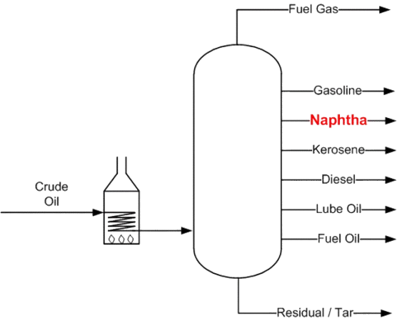
Why the Spread V1 // Do not use
Economic Reason: Supply vs. Demand Dynamics
Technical Reason 1. The Octane difference:
1. End-Use Competition:
Petrol has a "captive" market in the transportation sector.
Naphtha is primarily a Petrochemical Feedstock used to make plastics.
2. Naphtha’s Cheaper alternatives: LPG or Ethane used by Stream Crackers
 | Naphtha | Gasoline (Petrol) | Gap %
RON | 40 – 70 | 91 – 100+ | 23% – 60%
MON | 35 – 65 | 82 – 92 | 21% – 62%
AKI | 37 – 68 | 87 – 94 | 22% – 61%
2. Refinery Processing - Catalytic Reformer or Isomerization Unit.
3. Blending Components - Alkylate, Ethanol
25 ⁰ C
Unit | Cost/MT ($) | RON Range | Cost per Octane Point ($/RON)
Catalytic Reformer | 6.32 – 12.30 | 94 – 104 | 0.06 – 0.13
Isomerization | 3.40 – 8.10 | 80 – 93 | 0.04 – 0.10
>350 ⁰ C
Blending Component | Typical Cost ($/MT) | Octane (RON) | Notes
Alkylate | $850 – $1,150 | 94 – 98 | Premium gasoline blendstock, low sulfur, low aromatics
Ethanol (Fuel Grade, Anhydrous) | $600 – $900 | 108 – 110 | Oxygenate, subject to blending limits (typically 10–20%)

Slide 5
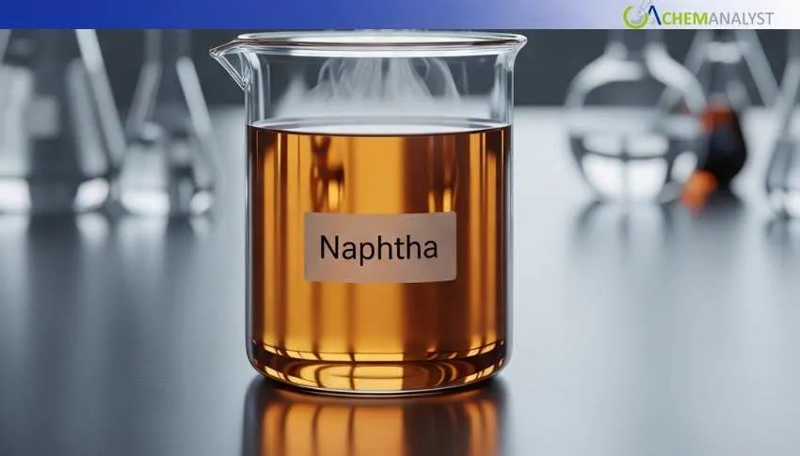
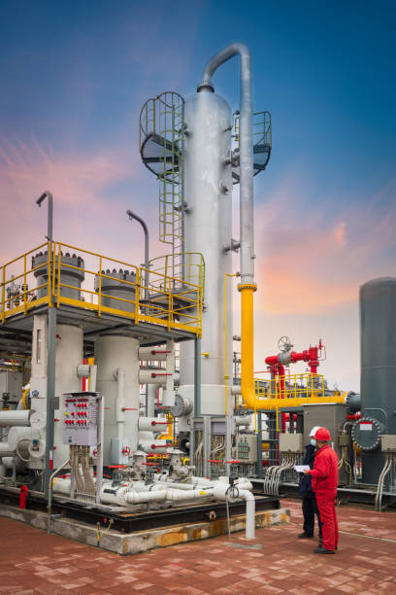
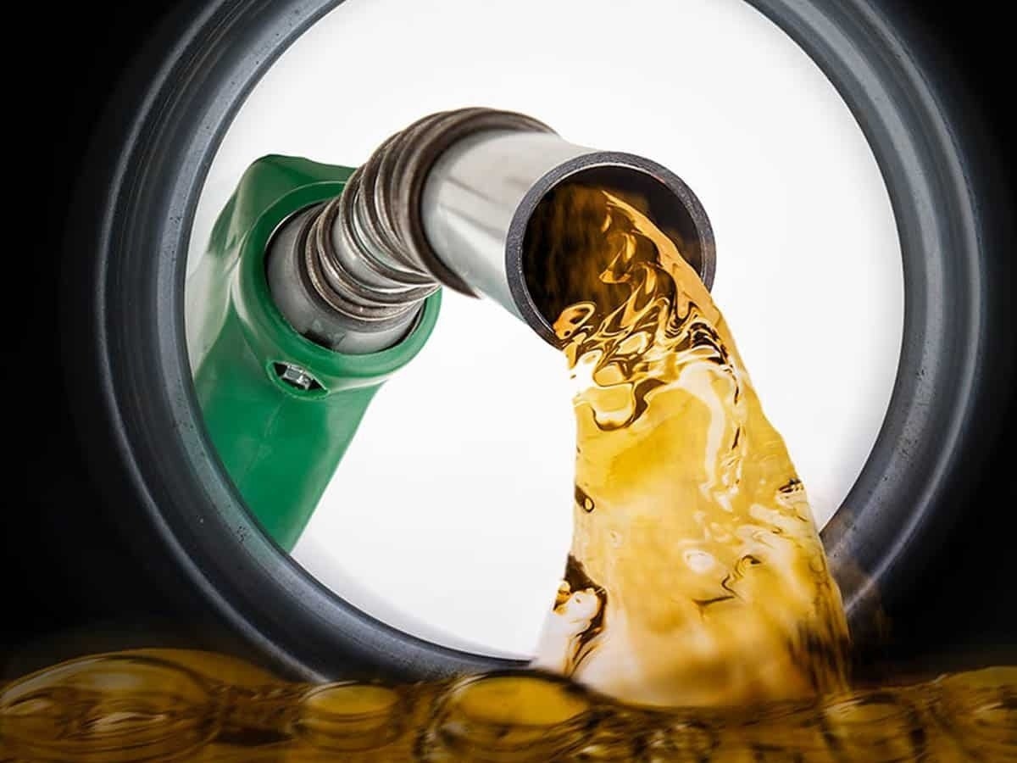
Why the Spread? V1
The Octane Difference | RON: 40 – 70 |  | RON: 91 – 100+
Price (USD/MT) 20 Feb 2026 | ~$560 | The Spread | ~ $750
Naphtha
Refinery Processing
& Blending Components
Petrol
Refinery Processing | Cost/MT ($) | Cost per Octane Point ($/RON)
Catalytic Reformer | 6.32 – 12.30 | 0.06 – 0.13
Isomerization | 3.40 – 8.10 | 0.04 – 0.10
Blending Component
Alkylate | $850 – $1,150 | 0.09 – 0.12
Ethanol (Fuel Grade, Anhydrous) | $600 – $900 | 0.06 – 0.08

Slide 6
Why the Spread?

Slide 7
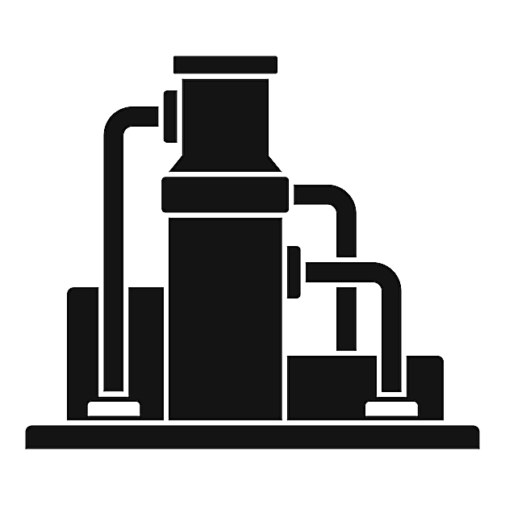

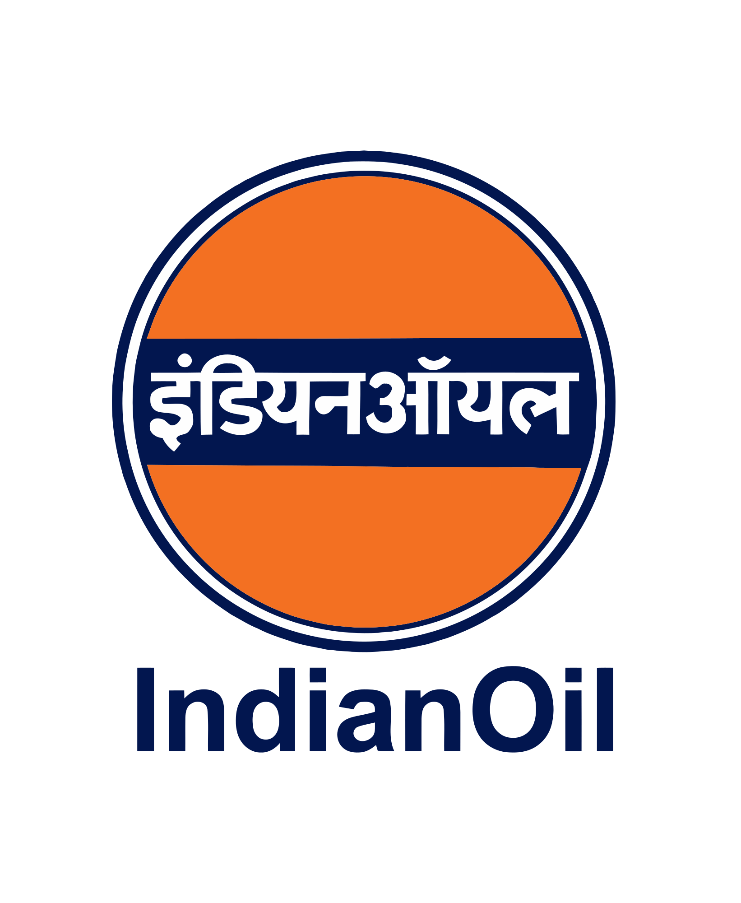




Market Reality: High Volume, Low Optimization
('000 Metric Tonnes)
 | 25-26 | 24-25 | 23-24
IMPORT
Crude oil | 185155 | 243225 | 234262
LPG | 16625 | 20667 | 18514
Naphtha | 824 | 941 | 1211
EXPORT
LPG | 423 | 551 | 525
Naphtha | 4776 | 5169 | 5275
Key Producing & Refining Players:

Slide 8
Global Players – Crude Oil
Upstream | Midstream | Downstream
Production | Refining | Consumption
Country | Data (Million Tonnes/Year) | Economic Value (Billion USD)
United States | 691 | 349
Saudi Arabia | 503 | 254
Russia | 501 | 253
Country | Data (Million Tonnes/Year) | Economic Value (Billion USD)
China | 868 | 439
United States | 892 | 451
Russia | 354 | 179
Country | Data (Million Tonnes/Year) | Economic Value (Billion USD)
United States | 946 | 478
China | 817 | 413
India | 279 | 141

Slide 9
Global Crude Oil – Supply Chain
Country |  | Crude Oil (MMTPA) | Naphtha (MMTPA) | Gasoline (Petrol) (MMTPA)
US | U | ExxonMobil: 164; Chevron: 160 | Chevron NGLs: 24 | -
 | D | ExxonMobil: ~199; Marathon: 147; Valero: 159 | - | Marathon: 74
China | U | PetroChina: 189; Sinopec: 36 | - | -
 | D | Sinopec: 252; PetroChina: 276 | Sinopec: 13.5; PetroChina: 8.7 | Sinopec: 64; PetroChina: 50
Saudi Arabia | U | Saudi Aramco: 598 | Growing NGL: NA | -
 | D | Saudi Aramco: 204 | SABIC (Aramco Subsidiary): 35.6 | Saudi Aramco: NA
Russia | U | Rosneft: 184; Lukoil: 80; Gazprom Neft: 76 | - | -
 | D | Rosneft: 83; Gazprom Neft: 43 | - | -
India | U | ONGC: 18.6 ; BPCL: 1.8 | - | -
 | D | IOCL: 80.8; BPCL: 35.3 ; Reliance: 70 | IOCL: 3.2; Reliance PX: 4.6 | BPCL: 50
U – Upstream (Production & Import); D – Downstream (Refineries & Retail)

Slide 10
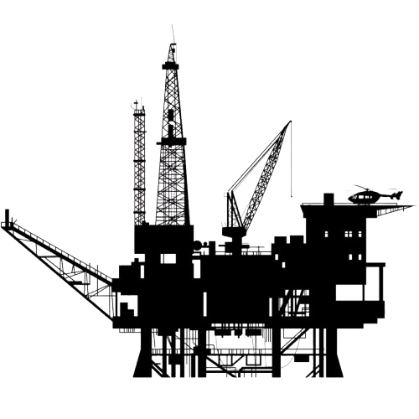
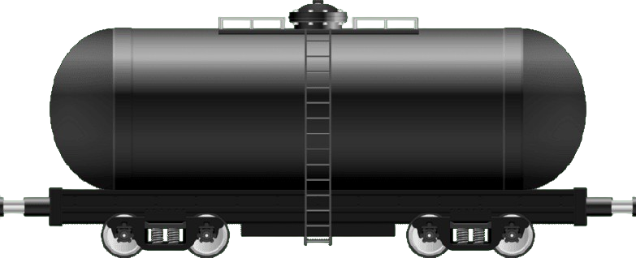
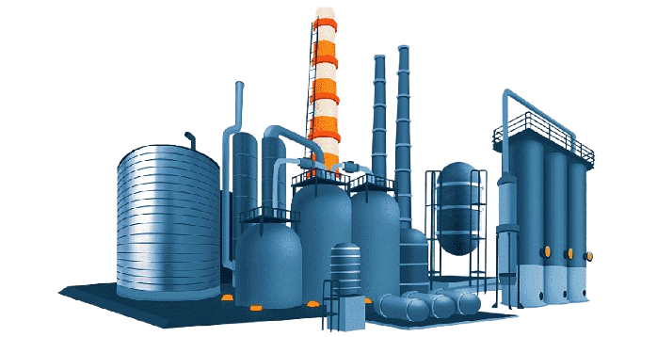
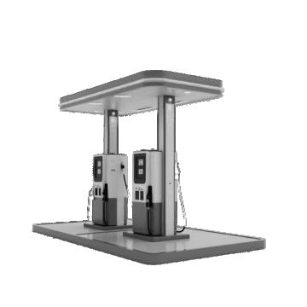
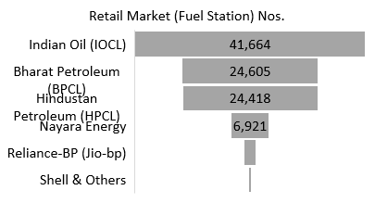
Value chain in India – Crude Oil
Upstream
Midstream
Downstream
Exploration & Production
Storage & Transport
Refine, Processing & Marketing

Slide 11
Why Naphtha Cannot Directly Replace Petrol?
Performance Limitation
• Lower octane than finished petrol • Engine knocking risk • Limited blending allowance
To upgrade it
refineries rely on catalytic reforming, significant capital and time
Infrastructure Requirement
• Needs catalytic reforming • High capital investment • Long construction timelines
Market Volatility
• Refining margins fluctuate • Crude benchmarks

Slide 12

THE GREEN FUEL

Slide 13
A Blending Enhancer That Elevates Naphtha Value // Will Modify – by Monika
Financially Viable
Eco friendly CoX, NoX, MoX free hance non polluting
Can be used in existing petrol engine without modification
Green Fuel : Naphtha/NGL-based fuel produced by breaking long-chain hydrocarbons to remove harmful components, increasing RON to petrol-comparable levels, and enabling direct use in existing petrol engines without heavy processing infrastructure.
Proprietary octane-enhancing blending formula
Enables naphtha to reach petrol-equivalent combustion characteristics
Compatible with existing blending operations
Lab validated

Slide 14

Capturing the Spread & Market Potential
Naphtha trades at discount to gasoline
Region | Gross Spread
Asia (Singapore/India) | $160 / tonne
Europe (ARA) | $150 / tonne
US (Gulf Coast) | $150 / tonne
2025-26
The Asia Specific Market Opportunity : $6.784 Billion
Petrol Consumption in India (MMT)
Fiscal Year | Consumption (MMT)
2023-24 | 37.2
2024-25 | 39.6
2025-26 | 42.4 (proj.)

Slide 15
Dual Revenue Strategy
Model 1:
Per Metric Ton Formula Sales
Direct supply to refiners / blenders
Recurring revenue
Margin linked to spread
Model 2 :
Licensing Model
License to:
Bharat Petroleum
TotalEnergies
Shell

